Slide 1
Chapter 14
Component-Level Design

Slide 2
Overview
What Is a Component
Designing Class-Based Components
  Basic Design Principles
  Comp. Level Design Guidelines
  Cohesion and Coupling
Conducting Comp. Level Design
  Steps of Comp. Level Design
Designing Conventional Components
Component-level design for Web/Mobile Apps

Slide 3
What is a component?
A modular building block for computer software
“A modular, deployable, and replaceable part of a system that encapsulates implementation and exposes a set of interfaces.”
— OMG UML Specification

Slide 4
Different Views of Component
OO View
  A component is a set of collaborating classes.
  Analysis modeling and design modeling are both iterative actions.
  Elaborating the original analysis class may require additional analysis steps, design modeling to represent the elaborated design class.

Slide 5
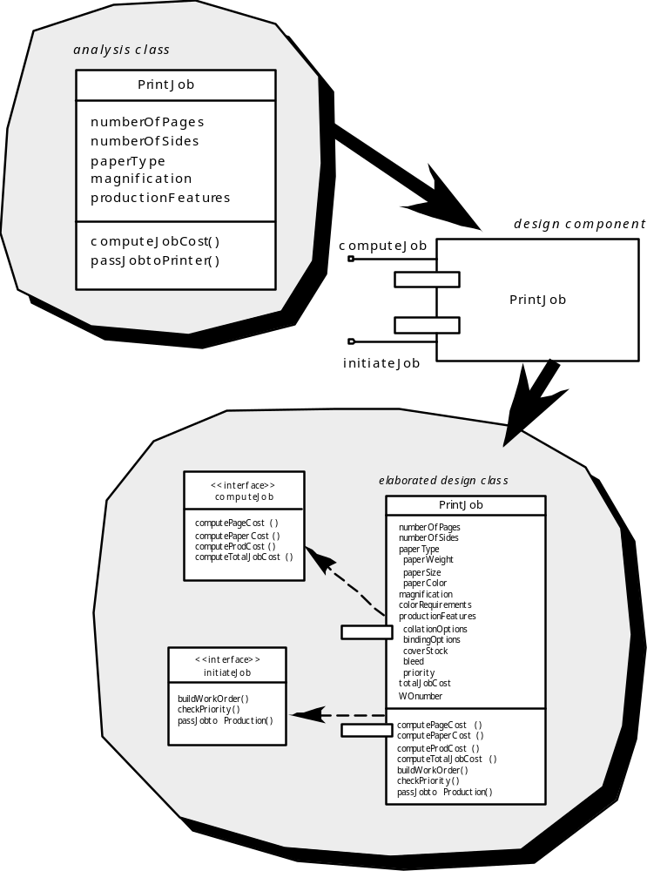
Analysis class
Requirements analysis → analysis class of PrintJob
Architecture design → component of PrintJob
Component-level design:
Interfaces: computeJob
initiateJob
Elaborated design class: to guide implementation
Data structure, Algorithmic detail, Interface
Design component
Elaborated design class
computeJob
initiateJob

Slide 6
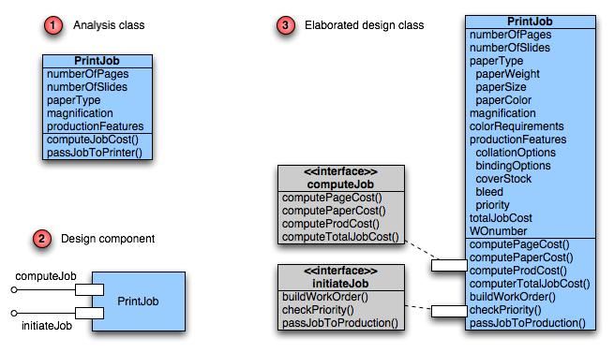
Class Elaboration（求精）

Slide 7
Different Views of Component
Conventional View（传统的观点）
  A component is a functional element of a program that incorporates:
    processing logic（处理逻辑）
    internal data structures（内部数据结构）
    an interface（接口）

Slide 8
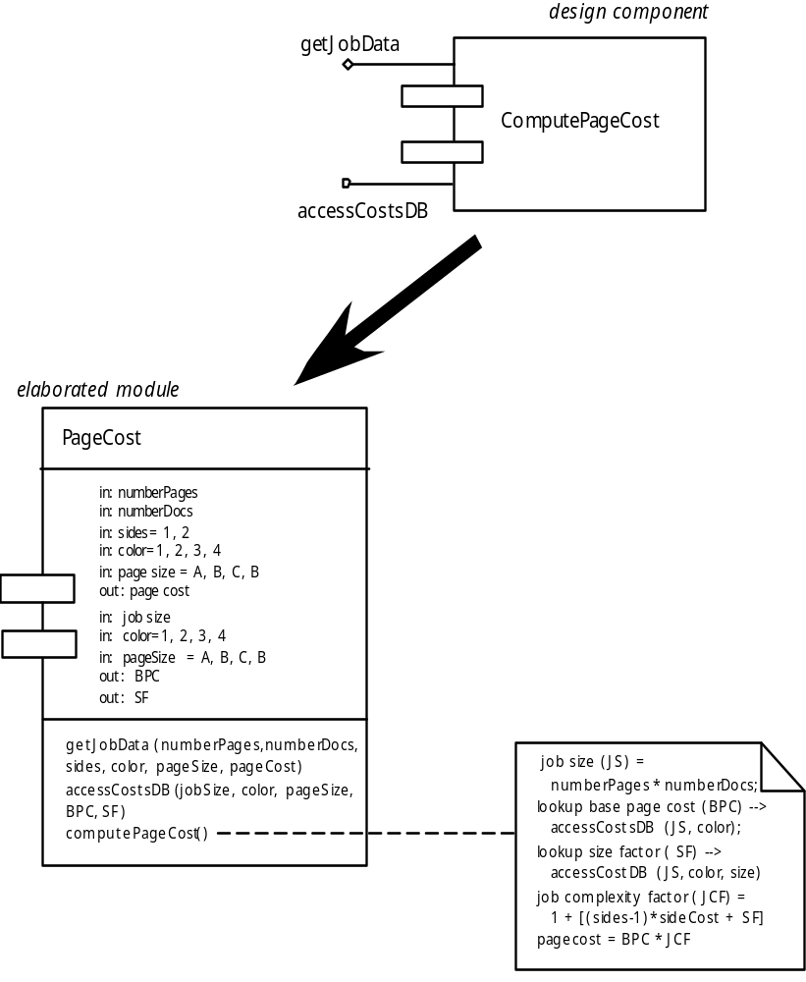
Design component
Requirements analysis → data flow diagrams
Architecture design → structure chart
Component-level design:
Each module in structure chart is elaborated
Interface, Data structure, Algorithmic detail, State diagram
getJobData module
accessCostsDB database
Elaborated module
algorithm detail

Slide 9
Different Views of Component
Process Related View
  Software is made by using existing component
  A component has reusability:
    Interface;
    Function（s);
    Communication and collaboration;

Slide 10
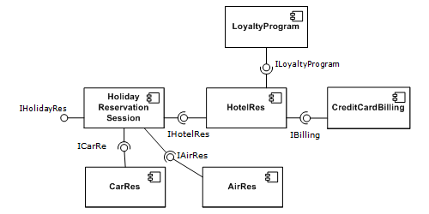

Slide 11
Overview
What Is a Component
Designing Class-Based Components
  Basic Design Principles
  Comp. Level Design Guidelines
  Cohesion and Coupling
Conducting Comp. Level Design
  Steps of Comp. Level Design
Designing Conventional Components
Component-level design for Web/Mobile Apps

Slide 12
What is Comp. Level Design?
A complete set of software components is defined during architectural design. But the details of each component are not represented.
Component-level design defines:
  Elaboration of analysis classes
  Definition and refinement of infrastructure classes
  Detailed description of the attributes, operations and interfaces of classes

Slide 13
Basic Design Principles
There are four basic design principles:
The Open-Closed Principle (OCP)
  A module should be open for extension but closed for modification.
The Liskov Substitution Principle (LSP)
  Subclasses should be substitutable（可替代） for their base classes.
Dependency Inversion Principle (DIP)
  Depend on abstractions. Do not depend on concretions（具体）.
The Interface Segregation Principle (ISP)
  Many client-specific interface are better than one general purpose interface.

Slide 14
Basic Design Principles
Additional packaging principles:
The Release Reuse Equivalency Principle (REP)
  The granule（粒度） of reuse is the granule of release
The Common Closure Principle (CCP)
  Classes that change together belong together.
The Common Reuse Principle (CRP)
  Classes that aren’t reused together should not be grouped together.

Slide 15
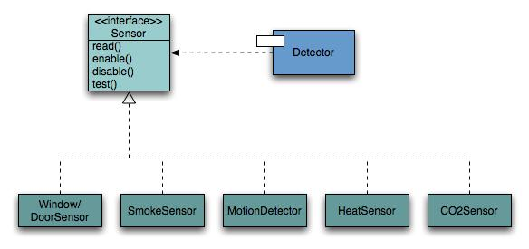
Open-Closed Principle
A module should be open for extension but closed for modification.（模块封装性）

Slide 16

Open chest surgery is not needed when putting on a coat.

Slide 17
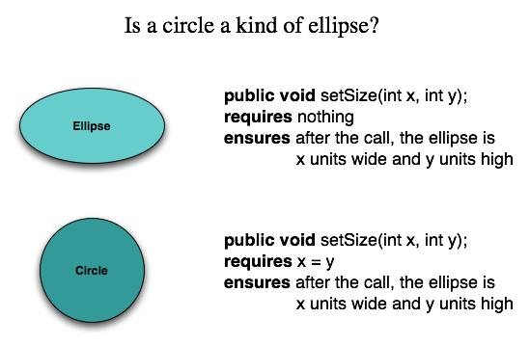
The Liskov Substitution Principle（替代原理）
Subclasses should be substitutable for their base classes

Slide 18
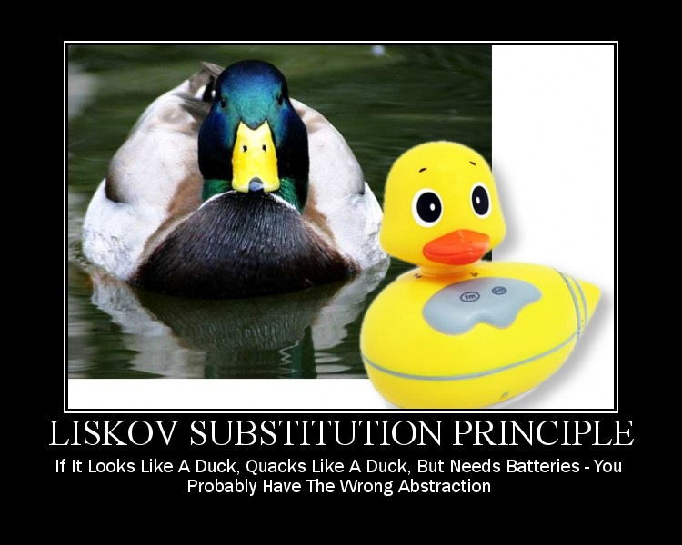
If it looks like a duck, quacks like a duck, but needs batteries – you probably have the wrong abstraction

Slide 19
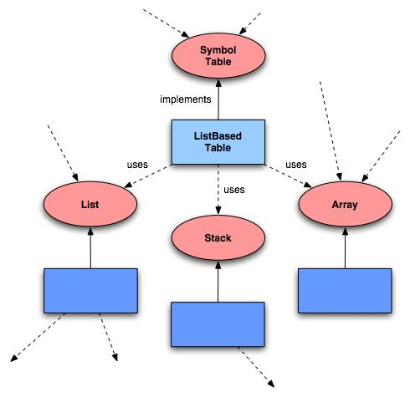
Dependency Inversion Principle
Depend on abstractions（抽象）. Do not depend on concretions（具体）.
  A. High-level modules should not depend on low-level modules. Both should depend on abstractions.
  B. Abstractions should not depend upon details. Details should depend upon abstractions.

Slide 20

Would you solder a lamp directly to the electrical wiring in a wall?

Slide 21
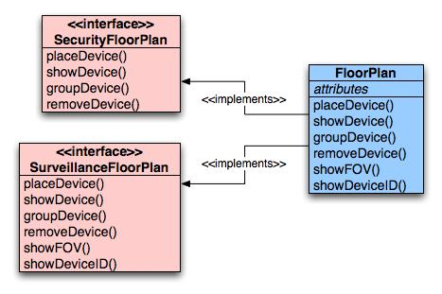
The Interface Segregation（分离） Principle
Many client-specific interfaces are better than one general purpose interface.

Slide 22
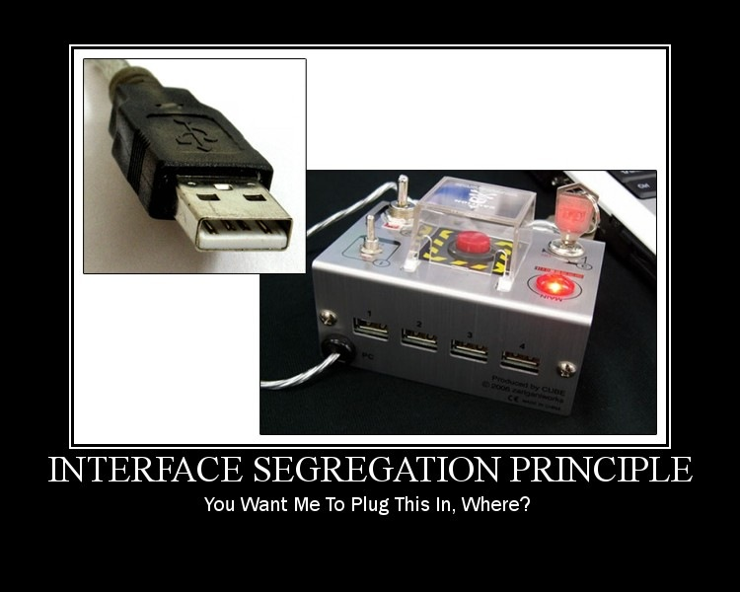
You want me to plug this in, where?

Slide 23
The Release Reuse Equivalency Principle
The granule（粒度） of reuse is the granule of release
Designing components for reuse requires more than good technical design.
It also requires effective configuration control mechanisms.

Slide 24
The Common Closure Principle
Classes that change together belong together.
Classes should be packaged cohesively.
This leads to more effective change control and release management.

Slide 25
The Common Reuse Principle
Classes that are not reused together should not be grouped together.

Slide 26
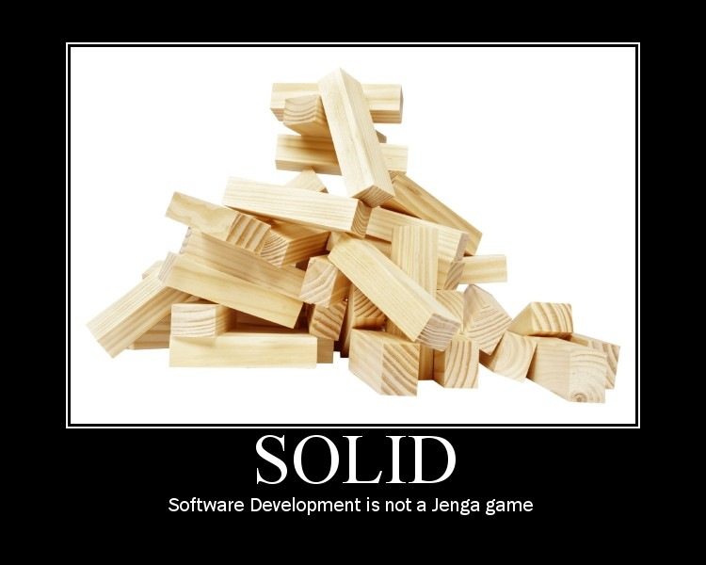
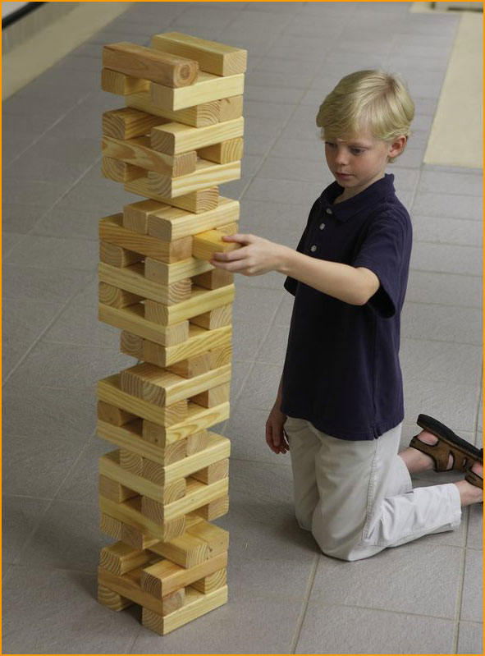
Solid: Software development is not a Jenga game.

Slide 27
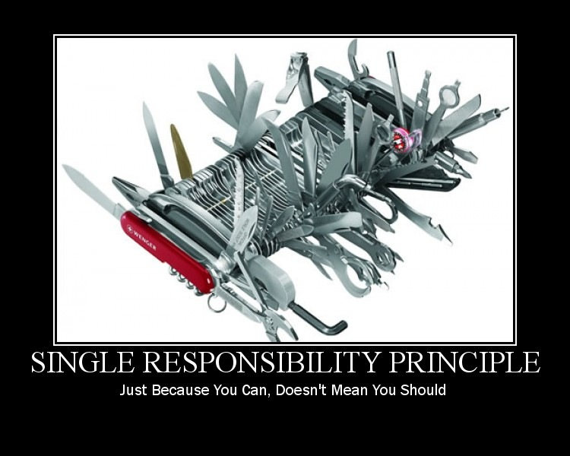
Single Responsibility Principle
Just because you can, doesn’t mean you should.

Slide 28
Component-level Design Guidelines
What should we consider when we name components?
Components
Interfaces
Dependencies and inheritance

Slide 29
Cohesion（内聚）
The “single-mindedness” of a component
cohesion implies that a component or class encapsulates only attributes and operations that are closely related to one another and to the class or component itself.
Examples of cohesion
  Functional
  Layer
  Communicational

Slide 30
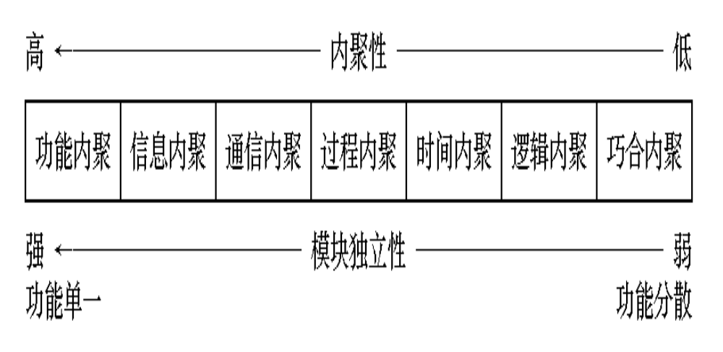
The elements of a module are directed to perform the same task.
Goal: as cohesive as possible.

Slide 31
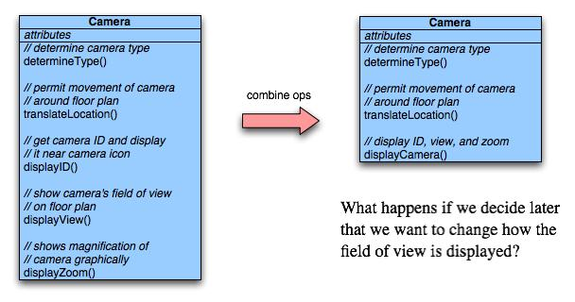
Functional Cohesion
Typically applies to operations. Occurs when a module performs one and only one computation and then returns a result.

Slide 32
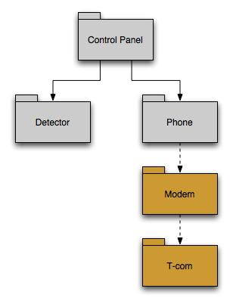
Layer Cohesion
Applies to packages, components, and classes.
Occurs when a higher layer can access a lower layer, but lower layers do not access higher layers.

Slide 33
Communicational Cohesion
All operations that access the same data are defined within one class.
In general, such classes focus solely on the data in question, accessing and storing it.
Example: A Student-Record class that adds, removes, updates, and accesses various fields of a student record for client components.

Slide 34
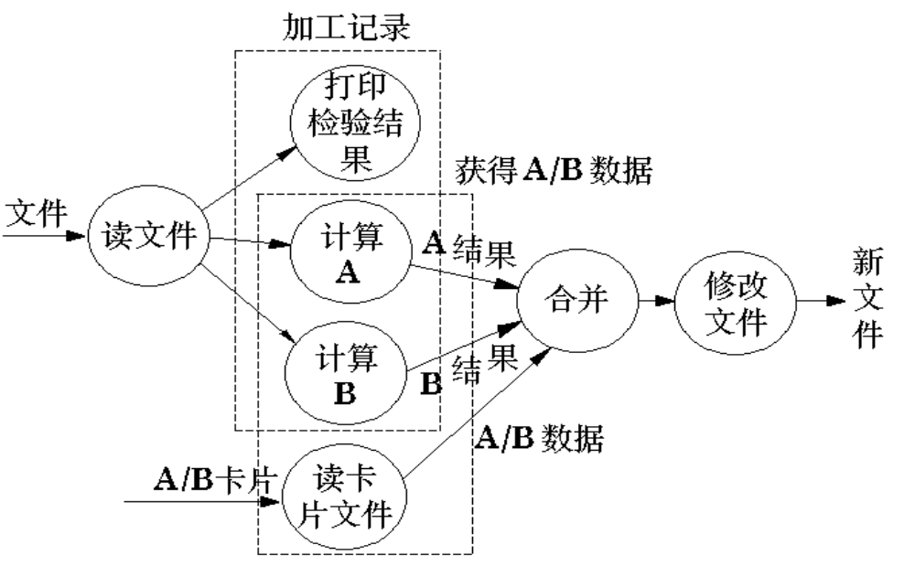
例1：从同一磁带上读取不相干的数据
—— 可能破坏独立性。
例2：

Slide 35
Coupling（耦合）
A qualitative measure of the degree to which classes or components are connected to each other.
Avoid
  Content coupling
Use caution
  Common coupling
Be aware
  Routine call coupling
  Type use coupling
  Inclusion or import coupling

Slide 36
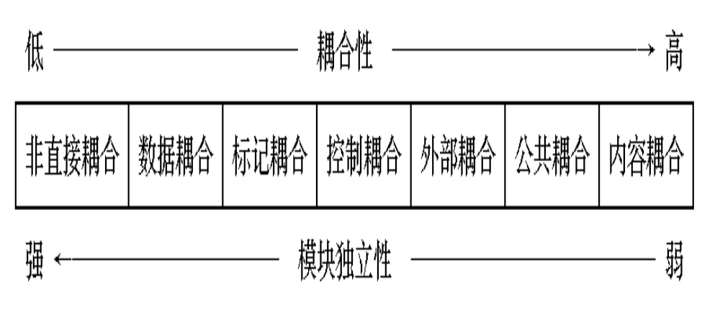
Coupling is a measure of interconnection among modules in a software structure. (Yourdon & Constantine,1978)

Slide 37
Content Coupling
Occurs when one component “surreptitiously（秘密地） modifies data that is internal to another component”
Violates information hiding
What’s wrong here? →
public class StudentRecord {
private String name;
private int[ ] quizScores;
public String getName() {
return name;
}
public int getQuizScore(int n) {
return quizScores[n];
}
public int[ ] getAllQuizScores() {
return quizScores;
}
….

Slide 38
……
例1：A访问C的内部数据或不通过正常入口而转入C的内部。
A
B
A:
…………
…………
goto C1
…………
…………
C
D
C:
…………
…………
C1:
……
……

Slide 39
例2：部分代码重叠（常出现在汇编程序中）
A
B
例3：一个模块有多个入口（功能）
A:
………………
………………
entry 1:
………………
………………
entry 2:
………………
………………
☹ The least desirable

Slide 40
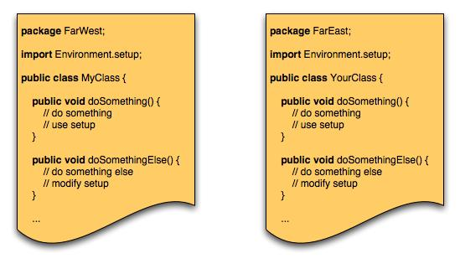
Common Coupling
Occurs when a number of components all make use of a global variable.

Slide 41
Data are accessible from a common data store.
Global : V1
V2
Global : V1
V2
A:
…………
…………
A1=V1+V2
…………
…………
B:
…………
…………
V1=B1
…………
…………
A:
…………
…………
V1++
…………
…………
B:
…………
…………
V2=B1+V1
…………
…………
问题：♣ 公共部分的改动将影响所有调用它的模块；
  ♣ 公共部分的数据存取无法控制；
  ♣ 复杂程度随耦合模块的个数增加而增加。

Slide 42
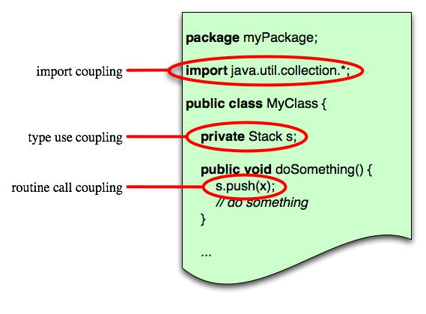
Routine Call Coupling
Certain types of coupling occur routinely in object-oriented programming.
Occurs when one operation invokes another.

Slide 43
Overview
What Is a Component
Designing Class-Based Components
  Basic Design Principles
  Comp. Level Design Guidelines
  Cohesion and Coupling
Conducting Comp. Level Design
  Steps of Comp. Level Design
Designing Conventional Components
Component-level design for Web/Mobile Apps

Slide 44
Steps of Component-Level Design
Identify design classes in problem domain
Identify infrastructure design classes
Elaborate design classes
Describe persistent data sources
Elaborate behavioral representations
Elaborate deployment diagrams
Refactor design and consider alternatives（可选方案）

Slide 45
Steps 1 & 2 – Identify Classes
Most classes from the problem domain are analysis classes created as part of the analysis model
The infrastructure design classes are introduced as components during architectural design

Slide 46
Step 3 – Class Elaboration
Specify message details when classes or components collaborate
Identify appropriate interfaces for each component
Elaborate attributes and define data structures required to implement them
Describe processing flow within each operation in detail

Slide 47
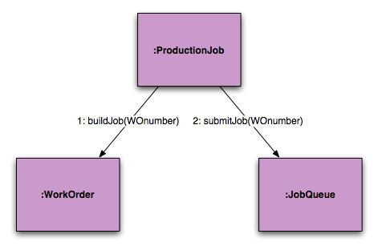
3a. Collaboration Details
Messages can be elaborated by expanding their syntax in the following manner:
  [guard condition] sequence expression (return value) :=
  message name (argument list)

Slide 48
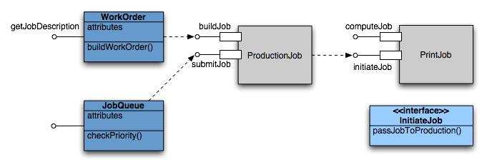
3b. Appropriate Interfaces

Slide 49
3c. Elaborate Attributes
Analysis classes will typically only list names of general attributes (ex. PaperType).
List all attributes during component design.
UML syntax:
  name : type-expression = initial-value { property string }
For example, paperType can be broken into weight, size, and color. The weight attribute would be:
  paperType-weight: string =
  “A” { contains 1 of 4 values – A, B, C, or D }

Slide 50
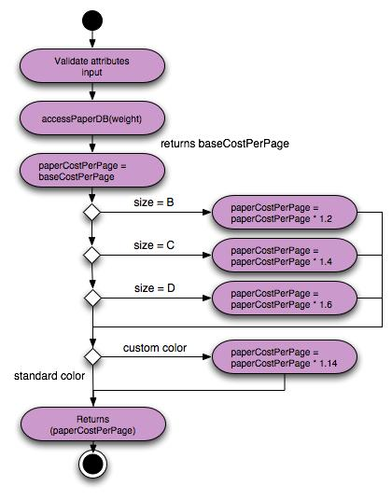
3d. Describe Processing Flow
Activity diagram for computePaperCost( )

Slide 51

Step 4 – Persistent Data
Describe persistent data sources (databases and files) and identify the classes required to manage them.

Slide 52
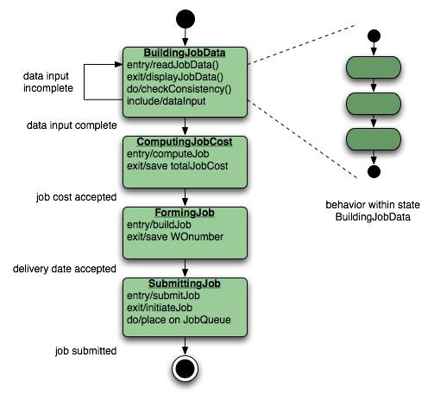
Step 5 – Elaborate Behavior
It is sometimes necessary to model the behavior of a design class.
Transitions from state to state have the form:
  Event-name (parameter-list) [guard-condition] / action expression

Slide 53
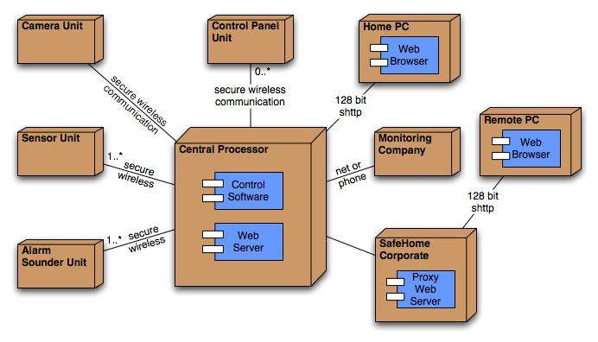
Step 6 – Elab. Deployment
Deployment diagrams are elaborated to represent the location of key packages or components.

Slide 54
Step 7 – Redesign/Reconsider
The first component-level model you create will not be as complete, consistent, or accurate as the n^{th} iteration you apply to the model.
The best designers will consider many alternative design solutions before settling on the final design model.

Slide 55
Overview
What Is a Component
Designing Class-Based Components
  Basic Design Principles
  Comp. Level Design Guidelines
  Cohesion and Coupling
Conducting Comp. Level Design
Designing Conventional Components
Component-level design for Web/Mobile Apps

Slide 56
Algorithm Design
the closest design activity to coding
the approach:
  review the design description for the component
  use stepwise refinement to develop algorithm
  use structured programming to implement procedural logic
  use ‘formal methods’ to prove logic

Slide 57
Stepwise Refinement
open
walk to door;
reach for knob;
open door;
repeat until door opens
turn knob clockwise;
walk through;
if knob doesn't turn, then
close door.
take key out;
find correct key;
insert in lock;
endif
pull/push door
move out of way;
end repeat

Slide 58
Algorithm Design Model
represents the algorithm at a level of detail that can be reviewed for quality
options:
  graphical (e.g. flowchart, box diagram)
  pseudocode (e.g., PDL) ... choice of many
  programming language
  decision table& tree
  folder
  conduct walkthrough to assess quality

Slide 59
Structured Programming for Procedural Design
uses a limited set of logical constructs:
sequence
conditional
— if-then-else, select-case
loops
— do-while, repeat until
leads to more readable, testable code
can be used in conjunction with ‘proof of correctness’
important for achieving high quality,
but not enough

Slide 60
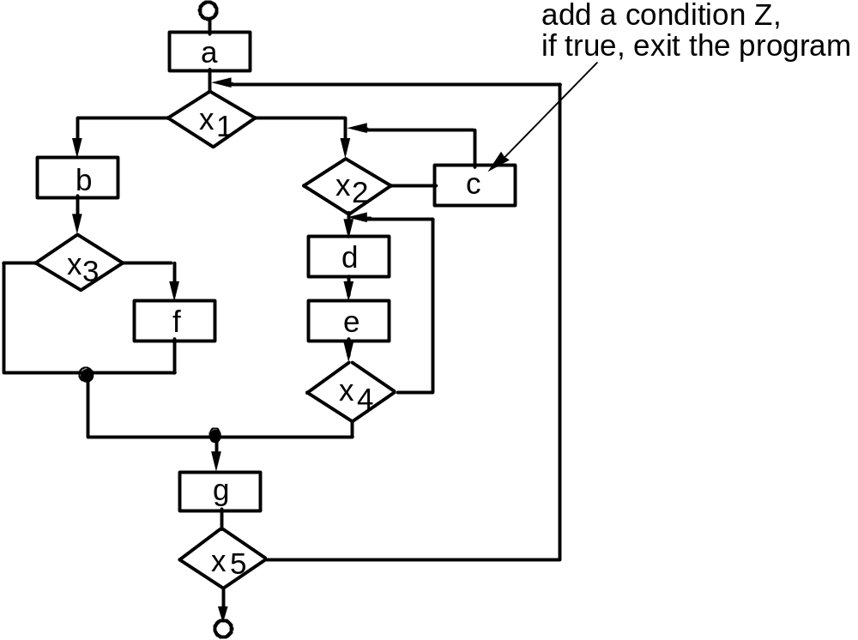
A Structured Procedural Design

Slide 61
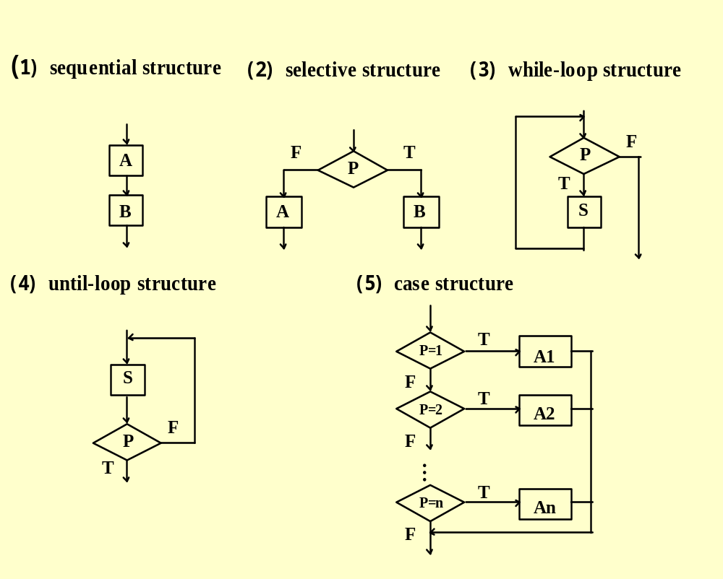
Program Flow Chart (PFC)
Program Flow Chart (PFC)
  sequence
  case
  selection
  while loop
  until loop

Slide 62
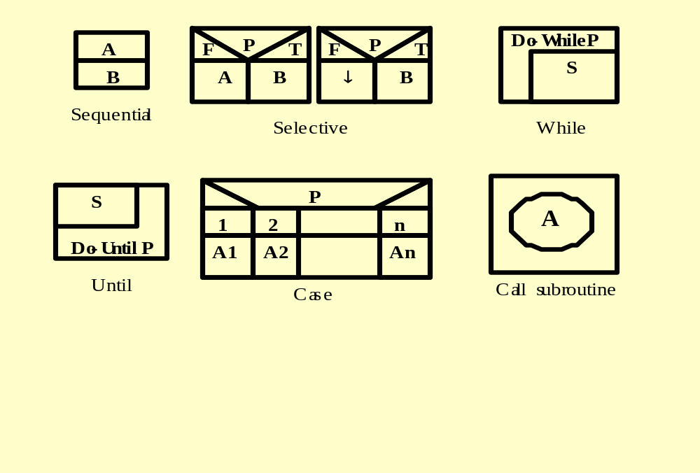
Box Diagram / N-S Chart

Slide 63
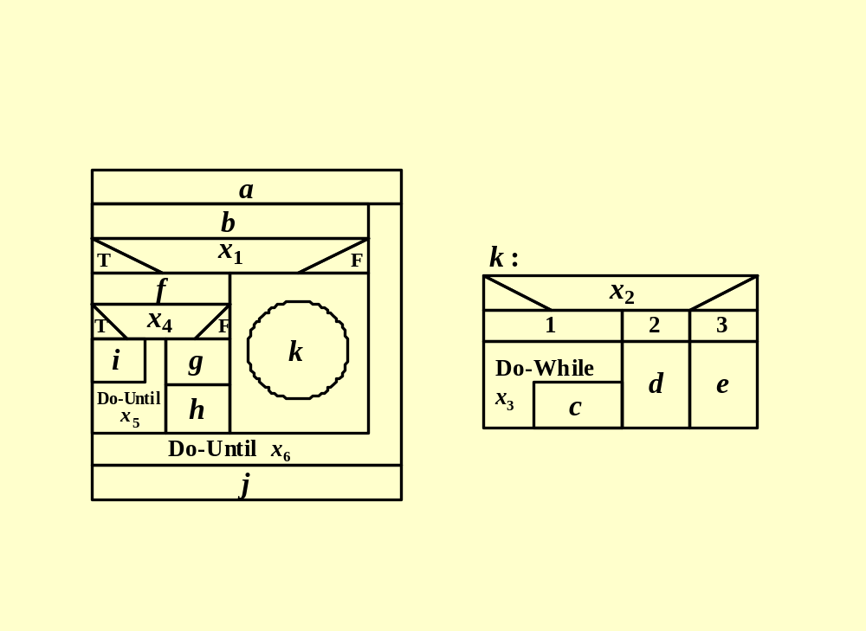
An Example

Slide 64
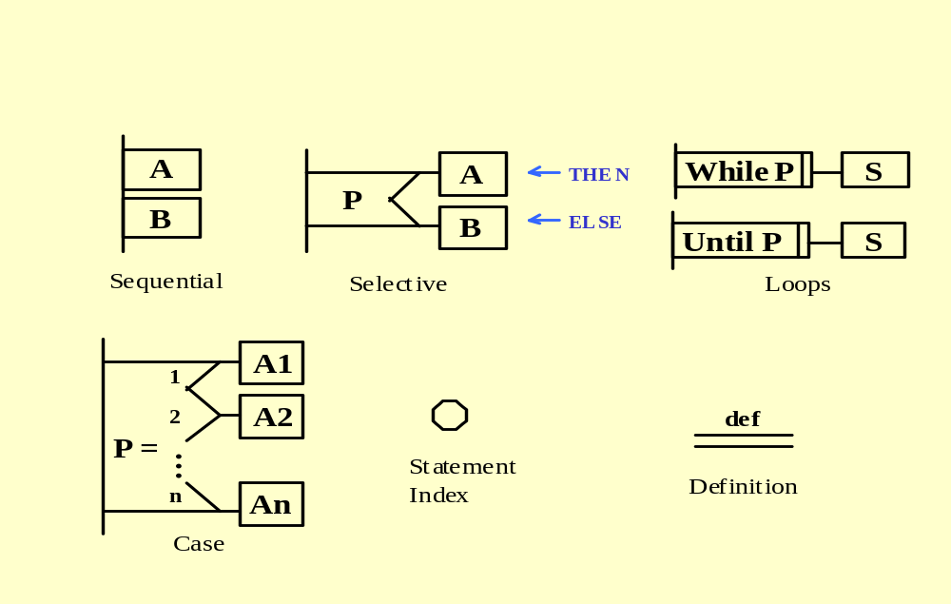
Problem Analysis Diagram ( PAD)

Slide 65
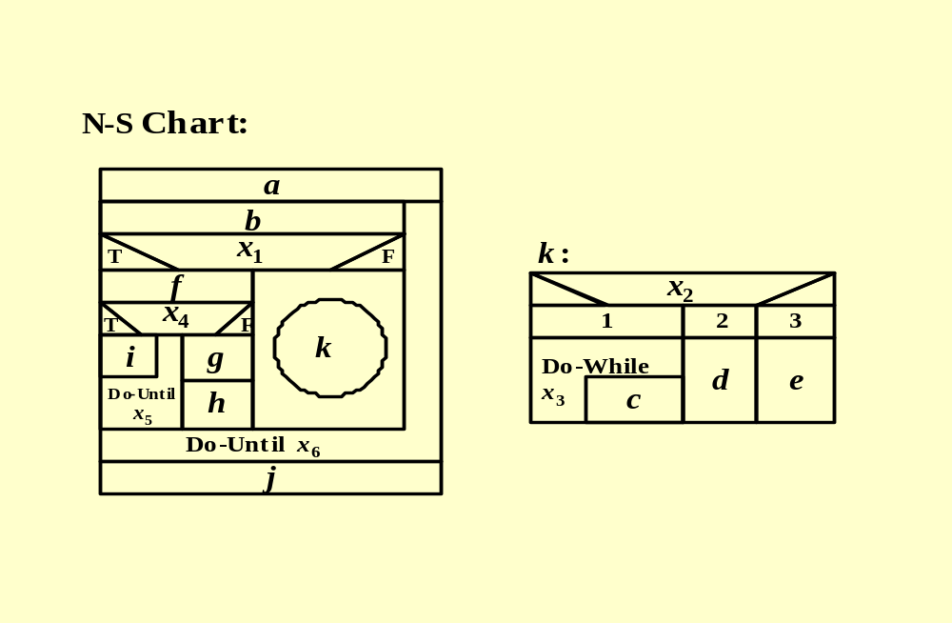
Example: From N-S Chart to PAD(1)

Slide 66
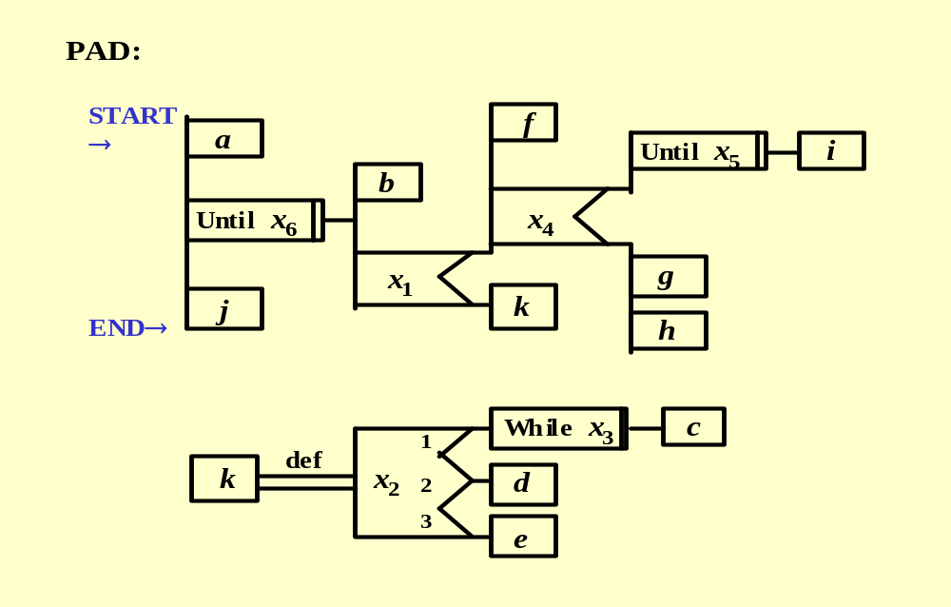
Example: From N-S Chart to PAD (2)

Slide 67
Tabular Design Notation
Decision table organization:
  a list of all conditions
  a list of all actions
  a set of processing rule

Slide 68
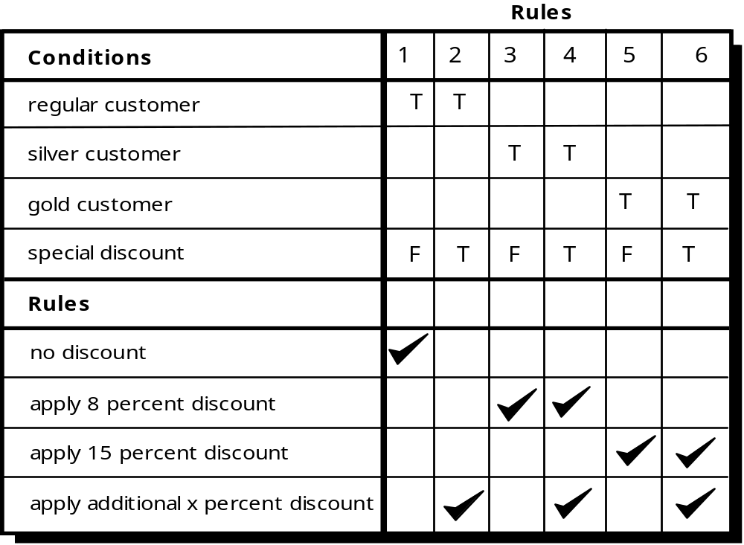
Decision Table

Slide 69
The steps of developing a decision table
  List all actions that can be associated with a specific procedure;
  List all conditions during execution of the procedure
  Associate specific sets of conditions with specific actions eliminating impossible combinations of conditions; alternatively, develop every possible permutation of conditions;
  Define rules by indicating what action(s) occurs for a set of conditions.

Slide 70
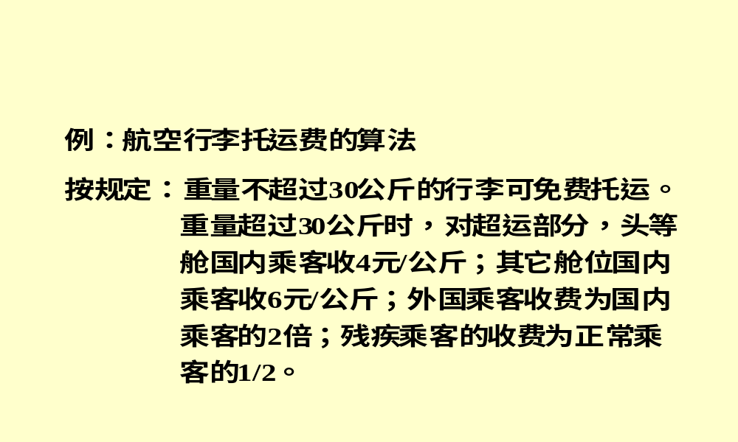
An Example of Decision Table (1)

Slide 71
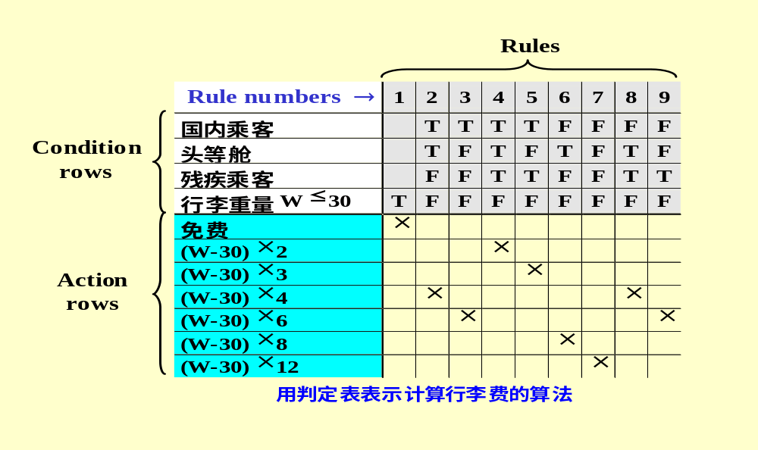
An Example of Decision Table (2)

Slide 72
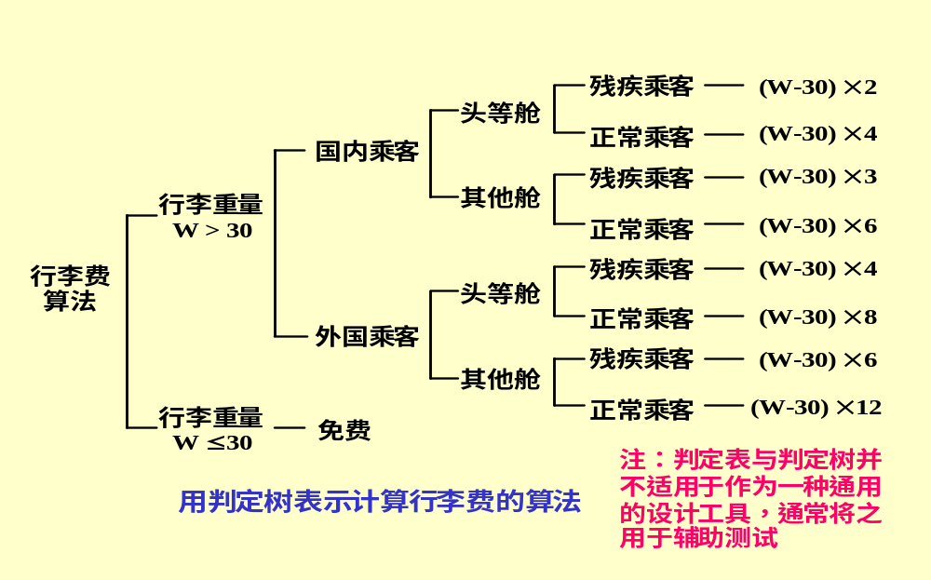
An Example of Decision Tree

Slide 73
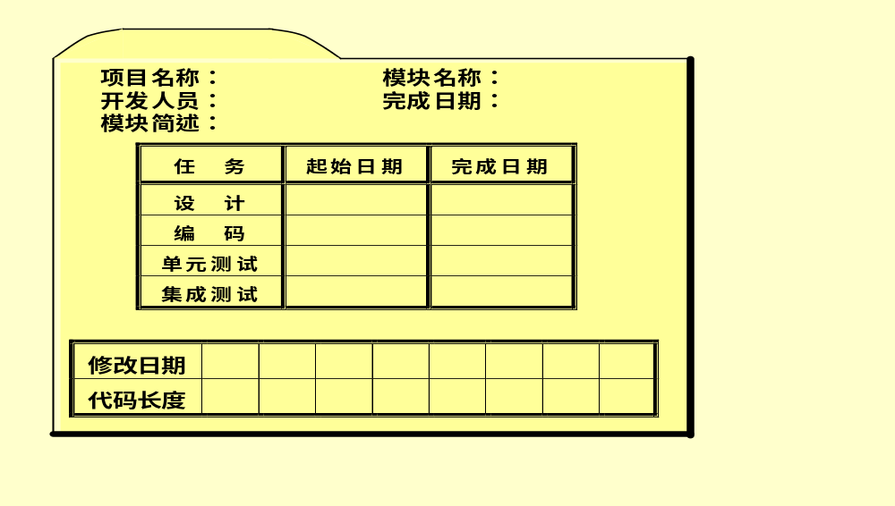
Folder
记录模块开发过程的文档。建议各组建立自己的文件夹。

Slide 74
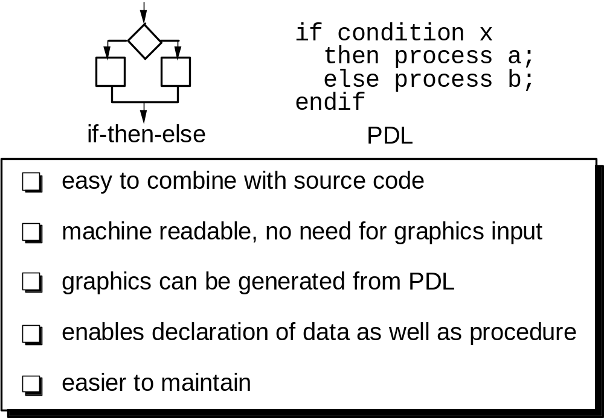
Program Design Language (PDL)

Slide 75
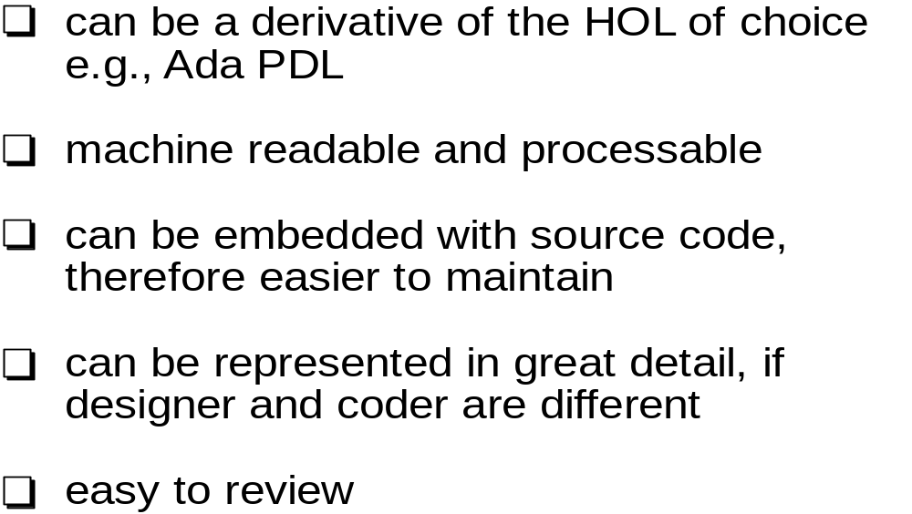
Why Program Design Language?

Slide 76
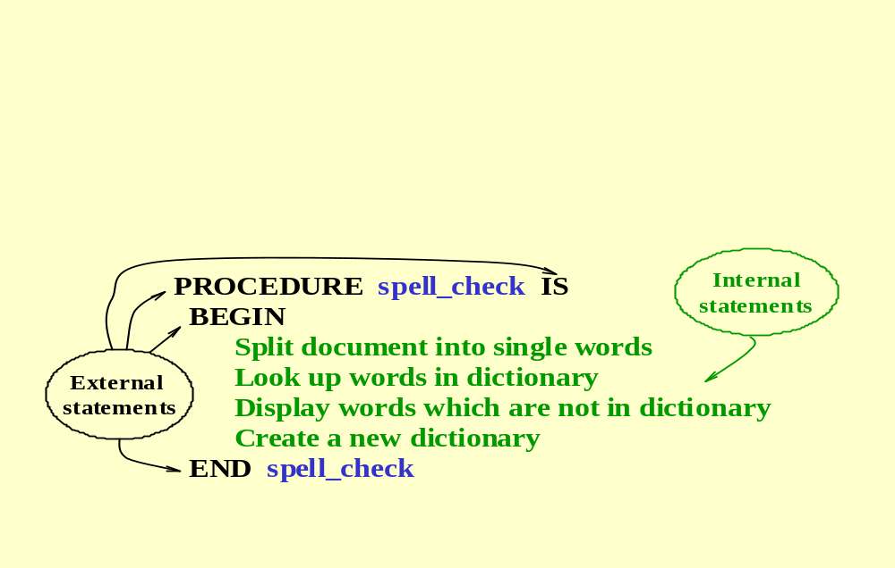
An Example

Slide 77
The Attributes of Design Notation
Modularity
Overall simplicity
Ease of editing
Machine readability
Maintainability
Structure enforcement
Automatic processing
Data representation
logic verification
“ Code-to” ability

Slide 78
Comparison of Design Natation
流程图
Ｎ－Ｓ图
ＰＡＤ图
ＰＤＬ语言
决策表
（树）
容易使用
好
好
好
很好
尚好
逻辑表示
尚好
好
好
好
很好
易编码
尚好
好
好
很好
好
易维护
不好
不好
尚好
好
好
自动处理
不好
不好
尚好
很好
很好
结构化构造
不好
很好
好
好
不适用
数据表示
不好
不好
不好
好
不好
块结构
不好
好
尚好
好
不适用
逻辑验证
不好
尚好
尚好
尚好
很好
使用频率
高
低
低
中等
低

Slide 79
Overview
What Is a Component
Designing Class-Based Components
  Basic Design Principles
  Comp. Level Design Guidelines
  Cohesion and Coupling
Conducting Comp. Level Design
Designing Conventional Components
Component-level design for Web/Mobile Apps

Slide 80
Component Design for WebApps
WebApp component is
  (1) a well-defined cohesive function that manipulates content or provides computational or data processing for an end-user, or
  (2) a cohesive package of content and functionality that provides end-user with some required capability.
Therefore, component-level design for WebApps often incorporates elements of content design and functional design.

Slide 81
Component Design for WebApps
focuses on content objects and the manner in which they may be packaged for presentation to a WebApp end-user
consider a Web-based video surveillance capability within SafeHomeAssured.com
  potential content components can be defined for the video surveillance capability:
    (1) the content objects that represent the space layout (the floor plan) with additional icons representing the location of sensors and video cameras;
    (2) the collection of thumbnail video captures (each an separate data object), and
    (3) the streaming video window for a specific camera.
  Each of these components can be separately named and manipulated as a package.

Slide 82
Functional Design for WebApps
Modern Web applications deliver increasingly sophisticated processing functions that:
  (1) perform localized processing to generate content and navigation capability in a dynamic fashion;
  (2) provide computation or data processing capability that is appropriate for the WebApp’s business domain;
  (3) provide sophisticated database query and access, or
  (4) establish data interfaces with external corporate systems.
To achieve these (and many other) capabilities, you will design and construct WebApp functional components that are identical in form to software components for conventional software.

Slide 83
Component Design for Mobile Apps
Thin web-based client
  Interface layer only on device
  Business and data layers implemented using web or cloud services
Rich client
  All three layers (interface, business, data) implemented on device
  Subject to mobile device limitations

Slide 84
Summary
What Is a Component
Designing Class-Based Components
  Basic Design Principles
  Comp. Level Design Guidelines
  Cohesion and Coupling
Conducting Comp. Level Design
  Steps of Comp. Level Design
Designing Conventional Components
Component-level design for Web/Mobile Apps

